Slide 1
Hacking Methods
1)Footprinting – the process of using passive methods of gaining information about the target system prior to performing the attack. The interaction with the target system is kept at minimum in order to avoid detection and alert the target about the attack.
The footprinting can reveal vulnerabilities of the target system and improve the ease with which they can be exploited.
whois queries, Google searches, job boards search, network enumeration, operating system identification, etc.
2)Scanning – the process of taking information obtained from the footprinting phase in order to target the attack more precisely.
Some of the metods used in this phase are port scans, ping sweeps, operating systems detection, observation of facilities used by the target, and so on.

Slide 2
3)Enumeration – the process of extracting more detailed information about the information obtained during the scanning phase to determine its usefulness.
Some of the methods : SMTP enumeration, DNS enumeration, etc.
4)System hacking – the process of planning and executing the attack based on the information obtained in the previous phases. In this phase the attacker performs the actual hacking process using hacking tools.

Slide 3
5)Escalation of privilege – the process of obtaining privileges that are granted to higher privileged accounts.
The goal of this step is to move from a low-level account (such as a guest account) all the way up to administrator.
6)Covering tracks – the process of removing any evidence of the attacker’s presence in a system.
The attacker purges log files and removes other evidence needed for the owner of the system to determine that an attack occured.
7)Planting backdoors – the process of securing unauthorized remote access to a computer, so the attacker can access the system later without being detected.
Backdoors are usually computer programs that give an attacker the remote access to a targeted computer system.

Slide 4
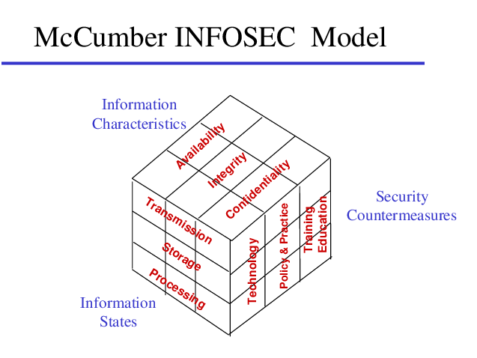
McCumber Model In 1991, John McCumber created a model framework for establishing and evaluating information security (information assurance) programs, now known as The McCumber Cube. This security model is depicted as a three-dimensional Rubik's Cube-like grid.

Slide 5
The concept of this model is that, in developing information assurance systems, organizations must consider the interconnectedness of all the different factors that impact them.
. To devise a robust information assurance program, one must consider not only the security goals of the program.
The McCumber model helps one to remember to consider all important design aspects without becoming too focused on any one in particular

Slide 6
Dimensions and attributes
Desired goals
Confidentiality: assurance that sensitive information is not intentionally or accidentally disclosed to unauthorized individuals.
Integrity: assurance that information is not intentionally or accidentally modified in such a way as to call into question its reliability.
Availability: ensuring that authorized individuals have both timely and reliable access to data and other resources when needed.

Slide 7
Information states
Storage: Data at rest (DAR) in an information system, such as that stored in memory or on a magnetic tape or disk.
Transmission: transferring data between information systems - also known as data in transit (DIT).
Processing: performing operations on data in order to achieve a desired objective.

Slide 8
Safeguards
Policy and practices: administrative controls, such as management directives, that provide a foundation for how information assurance is to be implemented within an organization.
Human factors: ensuring that the users of information systems are aware of their roles and responsibilities regarding the protection of information systems and are capable of following standards
Technology: software and hardware-based solutions designed to protect information systems (examples: anti-virus, firewalls, intrusion detection systems, etc.)

Slide 9
Defense-in-depth
is an information assurance strategy that provides multiple, redundant defensive measures in case a security control fails or a vulnerability is exploited.
Defense in Depth (DiD) refers to an information security approach in which a series of security mechanisms and controls are thoughtfully layered throughout a computer network to protect the confidentiality, integrity, and availability of the network and the data within.

Slide 10
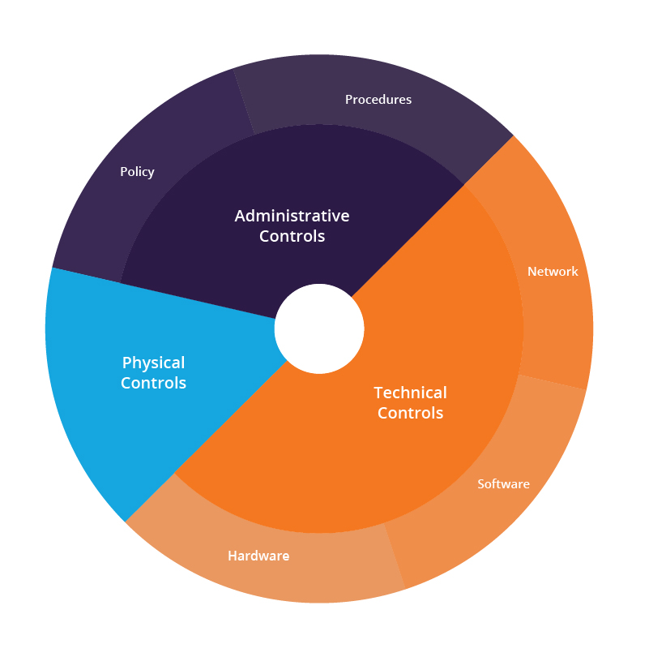
Defense in depth can be divided into three areas: Physical, Technical, and Administrative.

Slide 11
Administrative controls
Administrative controls consist of policies and procedures put in place by an organization to minimize vulnerabilities and to prevent users within the company from accessing information they are not authorized to access. Some layers of administrative controls could include:
Making sure that only current employees have user accounts, by putting a procedure in place to close an employee's account on the network in the event that someone leaves the company.

Slide 12
Putting detailed policies and procedures in place to ensure that all employees take the mandated steps required to secure corporate data, especially sensitive data.
Implementing role-based access control, which enables employees to only access the actual data that they need to do their own jobs. See our article on access control for more information about different access control schemes.

Slide 13
Implementing role-based access control, which enables employees to only access the actual data that they need to do their own jobs.
Minimizing the use of privileged accounts, such as administrator accounts, and placing additional restrictions on their use.

Slide 14
Physical controls
Physical controls are another crucial aspect of the layered approach. These include anything that prevents actual physical access to the IT system. For example:
Physical doors with locks in any area with computer equipment.
Fingerprint scanners for access to areas with computer equipment, and/or for logging into the system.
CCTV footage as a deterrent and to alert security to any possible cyber threats.

Slide 15
Security guards to monitor the area.
Gates to prevent easy access to the site.
Layers of physical controls could be the types of things described in the heist movie example - the multiple layers of protection that prevent the burglars from gaining access to the jewels.

Slide 16
Technical controls
These controls include software and hardware-based information security solutions that prevent unauthorized access to the IT network.
A combination of different hardware and software solutions provide the best protection from a wide array of cyber threats.
Layers of technical controls could include the following:

Slide 17
Securing authorization
Requiring users to use strong passwords that are difficult to guess or crack using password cracking tools.
Two factor authentication or multi-factor authentication (2FA/ MFA) to further verify the user's identity by using multiple devices to login.
Biometric authentication to ensure a user's identity through the use of facial recognition or fingerprint scanning, for example.

Slide 18
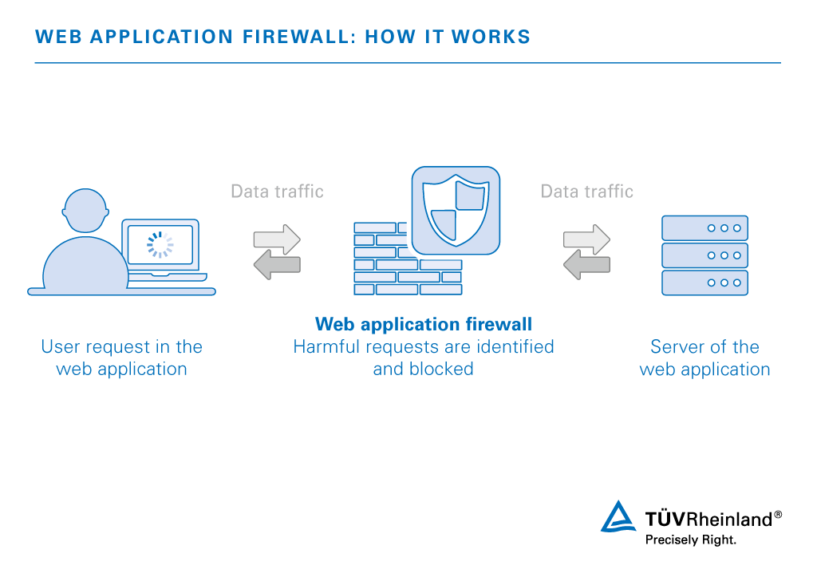

Slide 19
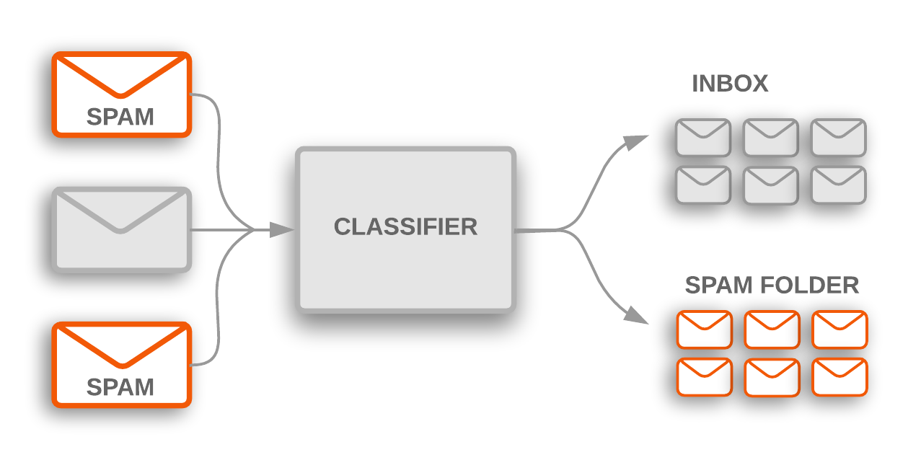
Anti spam software

